Slide 1
Projektpraktikum (BAKK thesis)
Project in IIS, Project in DS
2025s
Method and Topics
Author: Birgit Pröll
Date: 24.4.2025

Slide 2


Aim of Preliminary Meeting
Organisational Issues
Method / Process of Projektpraktikum, Project in IIS/DS
Topic Assignment
Individual meetings: topic details - starting next week & April
More Lecturers => mail/meet them individually
  Prof. Fürnkranz Topics https://teaching.faw.jku.at/Theses/Student%20Topics%20-%20FAW.pdf
  Prof. Küng, Prof. Wöß Topics: https://www.jku.at/en/institute-for-application-oriented-knowledge-processing/teaching/bachelor-masters-theses/
Requirements for course participation
  KUSSS registration
  Decision for topic today or until next Monday at the latest

Slide 3
My Fields of Interest
Search / Filtering / Recommendation
  Information Retrieval, Web Search
Information Extraction => Natural Language Processing (NLP)
  Focus on text
  Natural Language Understanding (NLU)
  Text/Opinion/Sentiment Mining
Dialogue Systems
  Chatbots, FAQs, Frameworks, Visualization aspects etc.
Web Application Issues
  E.g., Mockup-Driven Web-Application
Community/Cooperation/Competency Issues
  Community Informatics
  Profiles (Competency, Time, Location), Visualization, Evolution, Recommender/Matching
  Feedback, Reflection
  Persuasive Systems, „Goalifying“, Habit Changing Apps, Gamification

Slide 4
Organizational Issues
Individual working schedule
  Working plan incl. schedule
  Individual meeting every 3-4 weeks
    aim/agenda and input documents 1 day prior to the meeting
    meeting notes (short document, keywords => template)
  Review: online access to app
  Final BAKK/Project document & code, final presentation, video

Slide 5
Method / Process of Work
Aim
  Development of a demonstration prototype following a Software Engineering / Web Engineering process: requirements analysis (wide), conzeptualization (wide), implementation (specific & „smooth“), evaluation
  Based on knowlegde about literature (research) and (commercial) applications
  Application of CS-methods & techniques!
CS Methods/Techniques
  Method, SW-Process; user thinking (=> personas)
  Literature Review: Introduction to the field (state-of-the-art) => theory part
  Evaluation of existing systems/apps, evaluation of tools/approaches
  Requirement engineering methods: e.g., EARS, KANO; personas, user stories, scenarios
  Models: use case & activity diagrams, data & architecture model, web model, etc.
  Prototyping: MockUps, Frontend/Backend-Prototype, deployment (online accessible)
  Video & presentation(s)

Slide 6
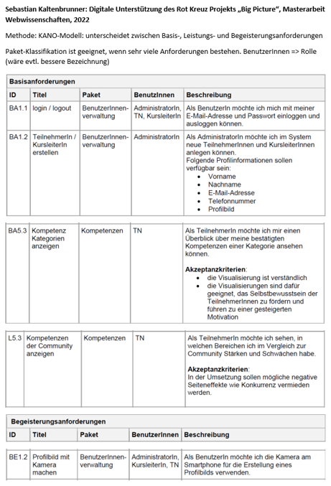
Example User Stories
Standards zB EARS, KANO
important infos (columns): ID, title, roles, description might already include attributes), might include alternative solutions, might include MoSCoW (must have, could, have, should have, could have, won’t have); moreover important: grouping as well as sorting of requirements
Example KANO-Modell taken from: Sebastian Kaltenböck: Digitale Unterstützung des Rot Kreuz Projekts „Big Picture“, Masterarbeit Webwissenschaften, 2022

Slide 7
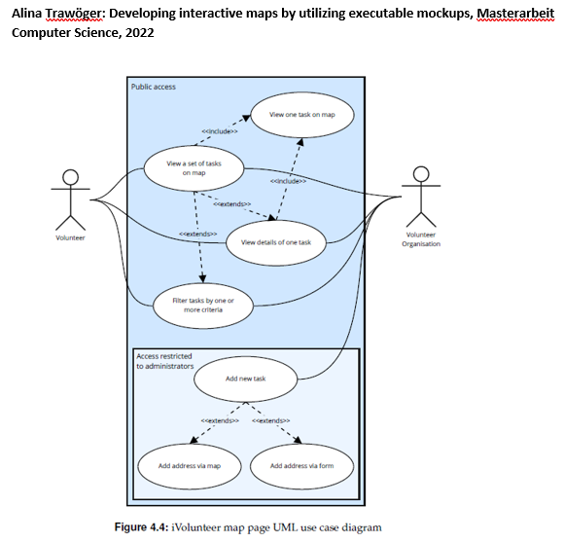
Example Use Case Diagram

Slide 8
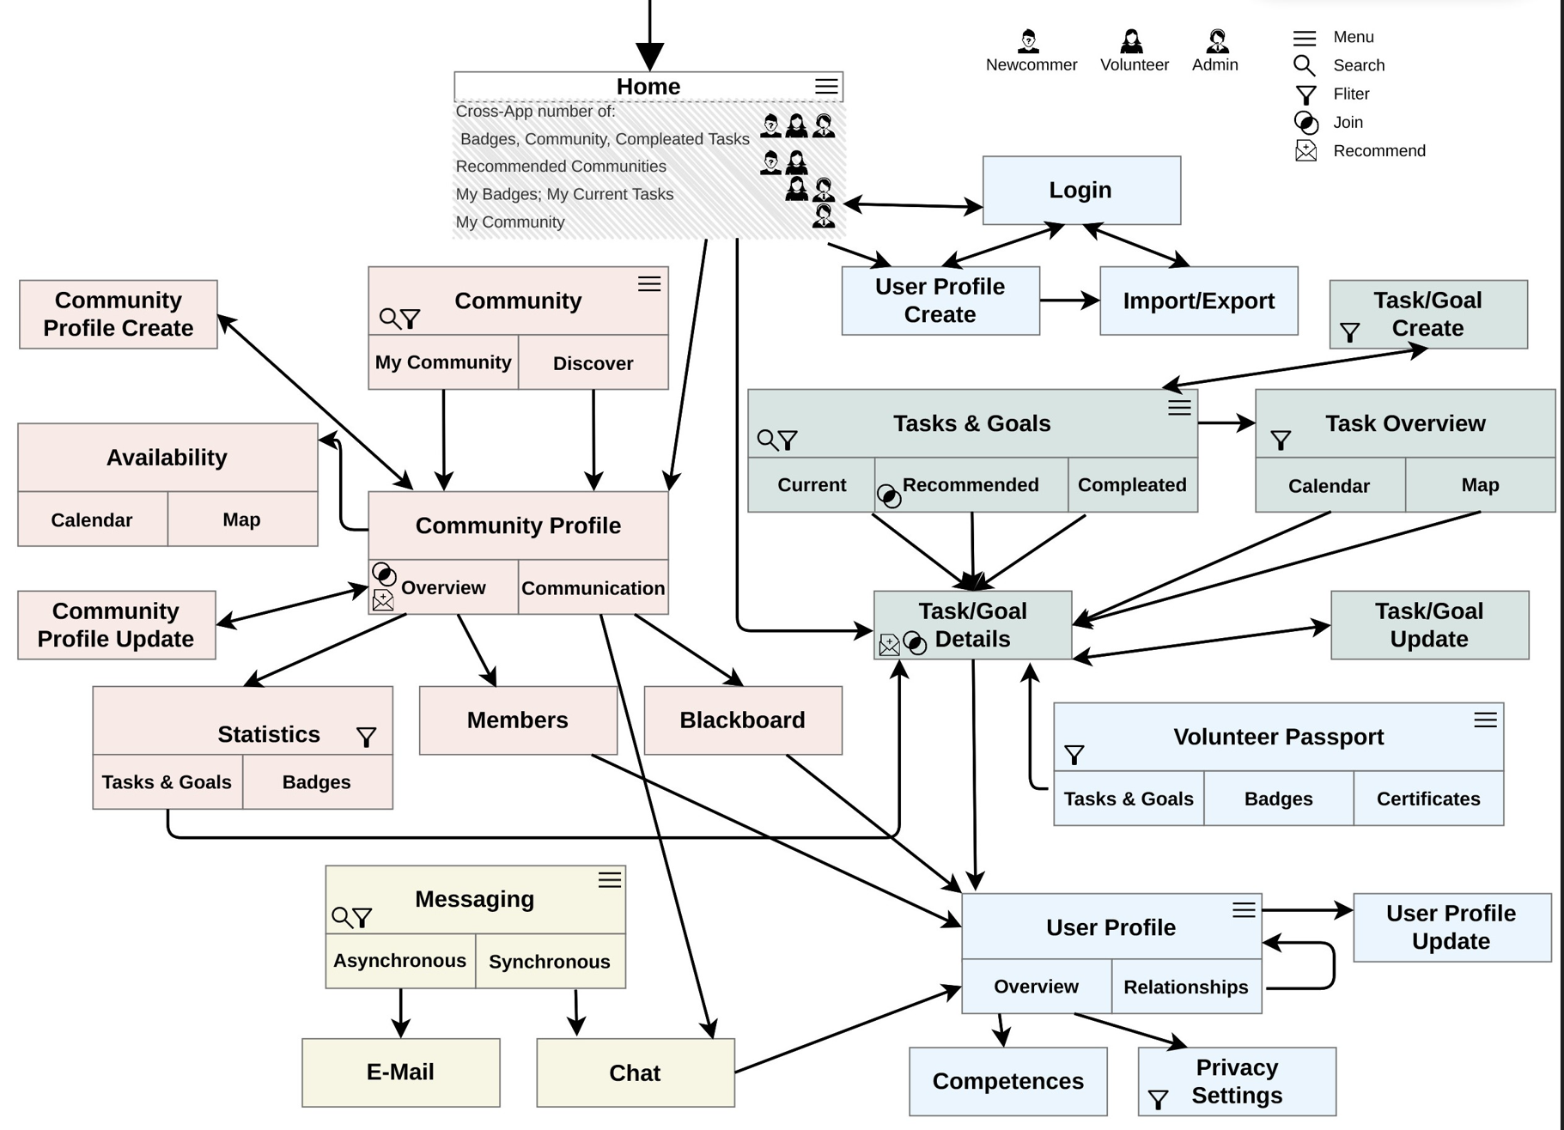
Example Web Model

Slide 9
Method / Process of Work
Deliverables
  ½ page aim and working plan => D1
  Requirement document inkl. scenario(s) and evaluation data => D2
  Concept and design results (models, achitecture, MockUps, etc.) => D3
  Demonstration prototype (online accessible) => D4
  Documentation incl. evaluation and resumee => D5
BAKK thesis
  Theory part: literature review and app/technical evaluations
  Approx. 50 pages – BUT dependent on content and completeness of documentation
  Table of Content (ToC): introduction/motivation, task description (requ. analysis), related work, concept & technical documentation (including installation guide), user documentation (screenshots), evaluation, sum up and resume
Project documentation
  Table of Content (ToC): short introduction, task description (requ. analysis), (related work), (app/technique evaluation), concept & technical documentation (including installation guide), user documentation, evaluation, sum up and resume
Project Presentation
  Deploy, Presentation, Video

Slide 10
Topic Overview
Volunteer Domain => Project CIvolunteer
Dialogue/Negotiation Visualization => Ricarda HUMER
Reveiling Volunteer Platform Heterogeneities
  1) Focus Interactive Diagrams – open topic
  2) Focus Crawling (for AI) – open topic
LLM-based Organisation Recommender => Richard HOANG
„Model-based“-Generation of Web-Pages => Philipp RIENER
Stepwise Onboarding => Isabella DRÖSCHER
Data Space for Volunteering => Alvaro JUAN GOMEZ (MA)
Text Generation from Structured Data in the Volunteer Domain
Graph Database(s) for Community Issues => Sebastian WINDSPERGER (MA)
User Interfaces for Volunteer Tasks: Search/Filter/Recommend – open topic (needs literature work to start with)
(Personalization in LLMs)
Competency Chatbot => Florian WEIGELT
Traffic Situation Awareness Domain => Project iReduce
Analysis of Textual Tickets => Jakob STRÖBITZER

Slide 11
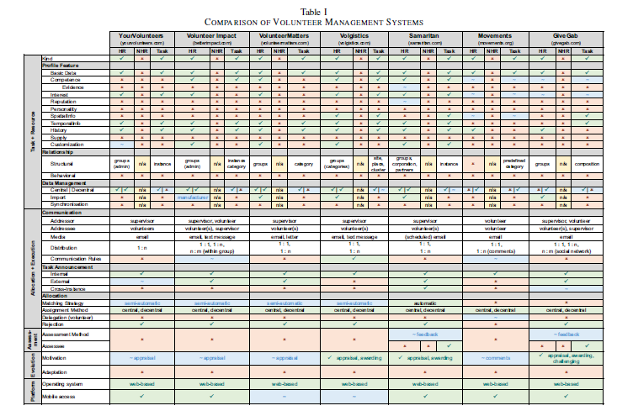
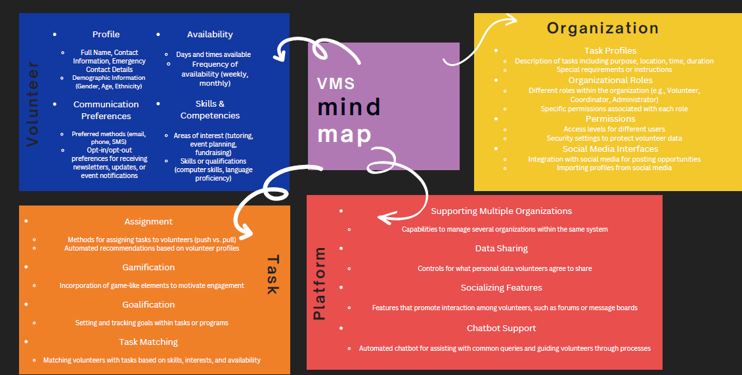
Reveiling Volunteer Platform Heterogeneities
1) Focus Interactive Diagrams – 2) Focus Crawling (for AI)
Volunteer Platform Selection and Catalogue of Heterogeneities
  Collect an encompassing list of volunteer platforms in Austria and worldwide
    Austria: there are more than 100 platforms (in German), e.g., https://treffpunkt-ehrenamt.at/
    International: e.g. BetterImpact, VolunteerMatters etc.
  Design a Catalogue of Heterogeneities => Mindmap
    Input idea: MA project Alsafa Neha: first draft of catalog of heterogeneities
    Volunteer profile (competencies, interests, time/location availability etc.), volunteer project/task’s (activity, opportunity) structure and workflow, organization & management (task management, onboarding etc.), community aspects (sharing, cooperation etc.), gamification/goalification etc.
  Present volunteer platforms: general info, heterogeneities, screenshots
  Provide sum-up table (see HICSS 2016)
[HICSS 2016 Evaluations of VMS: https://next.faw.jku.at/index.php/s/DHKokkgbZQ8f9xx]

Slide 12
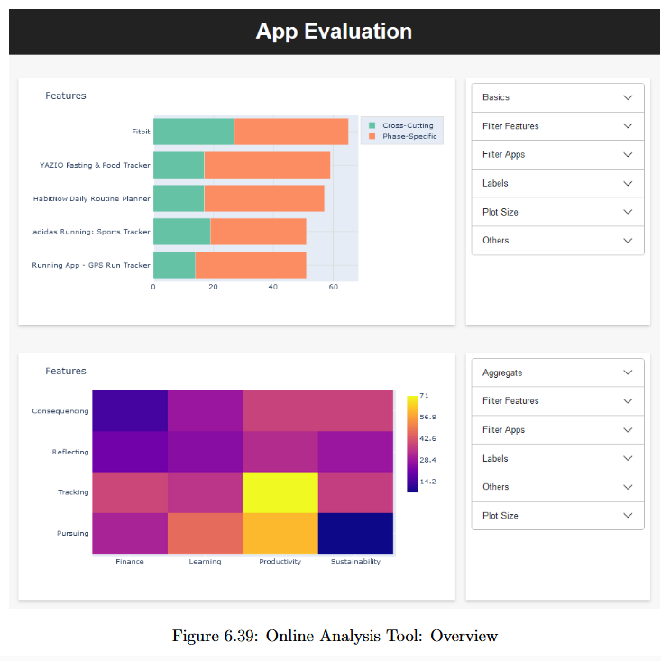
Reveiling Volunteer Platform Heterogeneities
1) Focus Interactive Diagrams
Prototype Application: (interactive) visualization of heterogeneities
  Heterogeneities might be extracted manually - can be stored in e.g., .xml/.css
  Diagrams shall visualize interesting aspects of evaluation results, eg does volunteer profile support attribute “interest”, as well as which value list is supported (e.g., sports, animals)
    Input idea: MA Bernadette Hammerle: evaluation of apps from different domains wrt. gamification issues
  Interactivity of diagrams: eg filters (which platforms support attribute “interests”, which platforms support goalification/gamification as such & specific elements)
  App shall be generic and adapt to eg new attributes (e.g. extension of catalog of heterogeneities)

Slide 13
Reveiling Volunteer Platform Heterogeneities
2) Focus Crawling (for AI)
Crawler Prototype
  Collect a list of crawlers and evaluate them wrt. general aspects
  Decide for a limited set of crawlers for the application
  Crawl volunteer platforms and extract heterogeneities
    knowledge base of keywords (e.g. interests)
    Extraction patterns
  Take into account issues for a follow-up LLM process (which is outside this work)
    Eg volunteer task: length of describing text
  Present results – has to be detailed
    Presentation of extracted heterogeneities
    Filter/search

